Slide 1

Driving Your Own Future
Prepared for:
YOU

Slide 2
Performance Path How we do it
4 | Revenue Performance & Metrics
How we measure real performance
Performance that focuses on results vs. activity
1 | Science & Strategy
Who we hunt.
Who is the most profitable to hunt?
Asset: MPC Accelerator
(Most Profitable Customer)
3 | Art & Talent Optimization
How to develop your team to being masters in their job.
Asset: Talent Accelerator
2 | Process & Customer Engagement
How we hunt in Marketing, Sales & Revenue Management
Installing new approach & thinking that is relevant
Create long-term impact; see rapid results
12
Notes:
How we do it

Slide 3
Performance Path Why it works
Having a strategic and disciplined path that equips the ability to pivot within marketplace shifts:
3. Focus:
Accountability on the right foundation
Repeatable Results.
2. Framework:
Build the tools and Resources to help teams to a sustain a new way of thinking
The uncommon becomes habit.
1. Foundation:
Build the new way to work so they know exactly what to do and when.
13

Slide 4
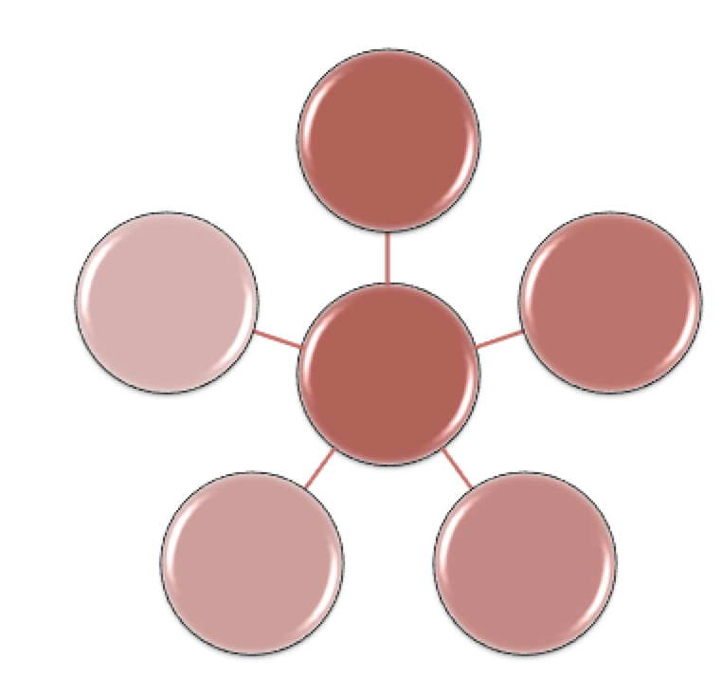
Framework Works!
Value Creation Framework
Value Proposition
Strategy Wheel
Value-Enabled™ Solutions
Customer Compass
Careabouts™
Third Box Thinking
© 2016, The Summit Group

Slide 5
Principle 1 – Value Creation Thought Framework
THEM
US
FIT
PROOF
What do your customers care about?
What are their critical business issues?
What will be important to them?
What value do they rely on to win business with their customers?
What do their customers seek?
What do you have?
Products
Services
Solutions
Value Enablers
How does what you have IMPACT what they care about?
How do you articulate this value and validate based on relevant examples?
Prove It!!!
What Matters NEXT???

Slide 6
Principle 2- Customer Business Compass
Market / Customer / Competition
Operational
Organization & People
Financial
Notes:
The customer compass has five dimensions:
At the center is the compass – which represents the customer’s Vision & Strategy
The four dimensions represent the capabilities & initiatives the company must develop & implement to achieve their vision & strategy

Slide 7
Principle 3- Third-Box Thinking™
You
Future Employer
Their
Customer
Bring?
Care About?
Seek?
Notes:
3rd Box Thinking is one of these core value-creation principles – let’s discuss how this can work across different levels in your go-to-market approach
7

Slide 8
Principle 4- Careabouts
Customer Careabouts WHAT? | WHY Is This a Problem/Priority? | What Are They DOING About This Issue? | WHO Has Responsibility for It?

Slide 9
Principle 6- Value Hypothesis
What do they care about? THEM | What do you have? How are you different? US | Impact FIT | Where have you done this before? PROOF
Identify customer issues
What could you potentially offer?
Describe impact in 1-3 word phrases
Prioritize and order the impact phrases

Slide 10
Crafting Your Value Hypothesis
Knowing your focus on…
We can help you with…
We do this by…
We have done this for…

Slide 11
Principle 6- Value Enablers (FIT) Where Do Solutions Impact Customer Business?
Which 2-3 areas are you going to impact? | What products and services could you use? | How would you measure that?

Slide 12
Principle 7 –Value Proposition
THEM
US
FIT
PROOF
What do your customers/customers’ customers care about? | What do you have? | How does what you have impact what they care about? (So what?) | Where/For Whom have you done this before? What were the results?

Slide 13
Revenue Methodology
Illustrative Kate & Co. Framework
Focus
Vision, Strategy & Planning
Go-to-Market Planning
Framework
Foundation
Science &
Strategy
Revenue
Management
Sales
Revenue
Operations
Profitable Growth
Process &
Customer
Engage-
ment
Marketing
Art & Optimization
Culture & Values
Leadership & Coaching
Notes:
Starts with how the customer wants to buy – not how you want to sell
Aligns stages in sales process with customer buying journey
Freedom in a framework (Iterative and agile, NOT rigid, prescriptive or robotic)
Common OS – yet scalable across verticals
Defines key activities taken at each stage in process – drives best practices
Progress tracked through customer verified progress e.g. request proposal,
Integrated from lead generation / prospecting, to qualification, to opportunity management and delivery / implementation
Integrates with SFDC objects e.g. Leads, Opportunities, Accounts, Territories, Contacts, Reports
Enables data analytics, insights and reporting
Enables coaching
Measurable (at rep, territory, region, company level)
EXPAND:
5 Key Touchpoints in the Customer Lifecycle: Creating Customers for Life
The ultimate goal of any business is to gain a customer for life. So how do you do that? Start by creating a customer journey that doesn’t just start at their time of purchase and end at contract expiration.
Do you know what your customer needs in between those two milestones? Understanding what your customer needs between onboarding and renewing can help you grow your relationship, gain your customers trust, and ultimately create a customer for life. Let’s start retaining customers by understanding the full scope of opportunities to reach out to them. There are many touchpoints in the complete customer lifecycle, let’s look at the top five:
“The economic value of a customer is realized over time, instead of upfront at the initial sale. Being successful increasingly requires that companies actively manage their customer during their engagement relationship.”
– Forrester
Identify Coverage Gaps | Do you have visibility into what customer products are not covered by a service contract? Your next sale could be right in front of you. If your customers have a vested interest in ensuring that the assets their business has purchased are protected over time, the chances are, they’ll be open to your sales pitch. At the very least, they’ll appreciate your efforts to help them manage their important investments.
Maximize Customer Investment Value | Help customers see value in their investments by promoting usage and sharing information about benefits, best practices, and tips/tricks. Measuring and monitoring your customer’s adoption/consumption – and using that data to engage with helpful reminders and utilization suggestions – will help ensure they are realizing value, while reinforcing your role as an adviser they can trust.
Evaluate Expansion Opportunities | Are there other assets or solutions your customer should consider? Demonstrate commitment to a customer’s business objectives by suggesting complementary solutions designed to improve network performance. By tracking and managing the lifecycle of these products, your business stands to gain an ongoing annuity stream that adds up over time.
Capitalize on Renewals | Capitalize on your annuities stream by effectively tracking your renewal opportunities. Map out engagement campaigns that are targeted and timely (suggested time frame: reach out to customers within one to three months or more of contract expirations), focused on renewing that subscription. If you have effectively engaged with your customer in the lifecycle touchpoints leading up to this point, the hope is that this renewal is a non-event, and your efforts can be spent pursuing other opportunities.
Know When to Refresh | By analyzing and monitoring product and service sales transaction data for end of life (the typical server, for instance, may need replacement after five to seven years), you can proactively get in touch with your customers at the right time with a new offer that addresses their business needs into the future. Keeping a pulse on their product needs means you’ll be ready when they are to buy a new product — it’s that simple.
Now may be a good time to reevaluate your post-sale customer engagement model to see if there are revenue opportunities that may be falling through the cracks. Here are some additional resources to help you get started:

